Slide 1
AWS Global Infrastructure

Slide 2
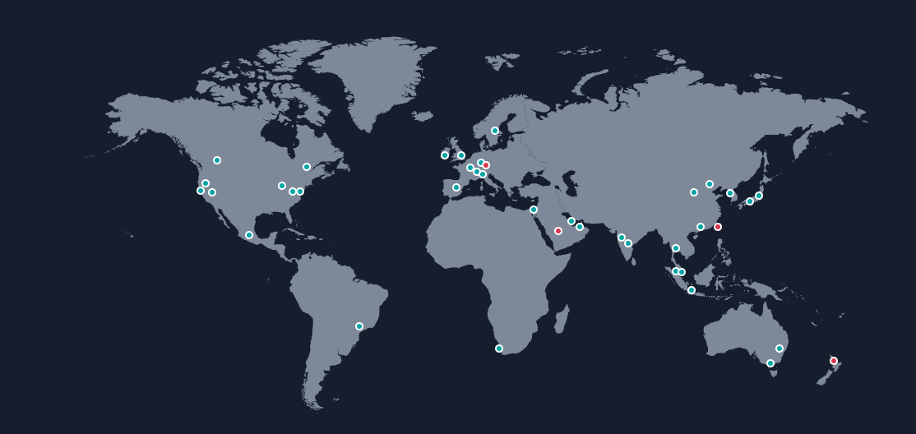
AWS Global Infrastructure
The AWS Global Infrastructure is designed and built to deliver a flexible, reliable, scalable, and secure cloud computing environment with high - quality global network performance.
AWS continually updates its global infrastructure footprint.
https://aws.amazon.com/about-aws/global-infrastructure/#AWS_Global_Infrastructure_Map

Slide 3
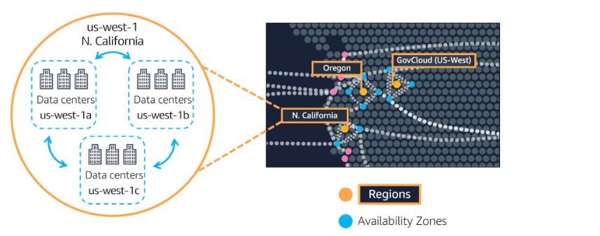
AWS Regions
Am AWS Region is a geographical area.
Data replication across Regions is controlled by you.
Communication between Regions uses AWS backbone network infrastructure.
Each Region provides full redundancy and connectivity to the network.
A Region typically consists of two or more Availability Zones
Notes:
The AWS Cloud infrastructure is built around Regions. AWS has 22 Regions worldwide. An AWS Region is a physical geographical location with one or more Availability Zones
Availability Zones in turn consist of one or more data centers.
To achieve fault tolerance and stability, Regions are isolated from one another. Resources in one Region are not automatically replicated to other Regions. When you store data in a specific Region, it is not replicated outside that Region.
It is your responsibility to replicate data across Regions, if your business needs require it.
AWS Regions that were introduced before March 20, 2019 are enabled by default. Regions that were introduced after March 20, 2019 such as Asia Pacific (Hong Kong) and Middle East
(Bahrain) are disabled by default. You must enable these Regions before you can use them. You can use the AWS Management Console to enable or disable a Region.
Some Regions have restricted access. An Amazon AWS (China) account provides access to the Beijing and Ningxia Regions only.
The isolated AWS GovCloud (US) Region is designed to allow US government agencies and customers to move sensitive workloads into the cloud by addressing their specific regulatory and compliance requirements.

Slide 4
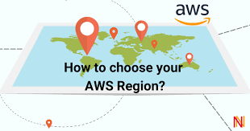
How to choose a Region
Determine the right region for your services, applications based on : -
Data Governance and legal requirements.
Proximity of customers.
Services available in region.
Costs (vary by region)
Notes:
There are a few factors that you should consider when you select the optimal Region or Regions where you store data and use AWS services.
One essential consideration is data governance and legal requirements. Local laws might require that certain information be kept within geographical boundaries. Such laws might restrict the Regions where you can offer content or services. For example, consider the European Union (EU) Data Protection Directive.
It is generally desirable to run your applications and store your data in a Region that is as close as possible to the user and systems that will access them. This will help you reduce latency.
Finally, there is some variation in the cost of running services, which can depend on which Region you choose

Slide 5
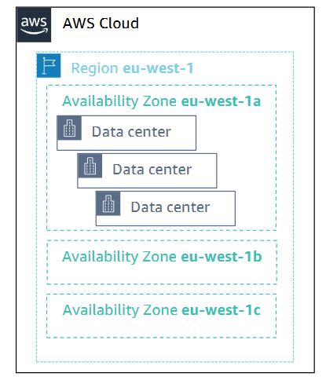
Availability Zone
Each Region has multiple AZ.
Each AZ is a fully isolated partition of the AWS Global Infrastructure.
Availability Zones consist of discrete data centers.
They are designed for fault isolation.
They are interconnected with other Availability Zones by using high-speed private networking.
You choose your Availability Zones.
AWS recommends replicating data and resources across Availability Zones for resiliency
Notes:
Each AWS Region has multiple, isolated locations that are known asAvailability Zones.
Each Availability Zone provides the ability to operate applications and databases that are more highly available, fault-tolerant, and scalable than would be possible with a single data center.
Each Availability Zone can include multiple data centers (typically three), and at full-scale, they can include hundreds of thousands of servers. They are fully isolated partitions of the AWS Global Infrastructure.
Availability Zones have their own power infrastructure, and they are physically separated by many kilometers from other Availability Zones.
Though all Availability Zones are within 100 km of each other. All Availability Zones are interconnected with high-bandwidth, low-latency networking over fully redundant, dedicated fiber that provides high-throughput between Availability Zones.
The network accomplishes synchronous replication between Availability Zones. Availability Zones help build highly available applications. When an application is partitioned across Availability Zones, companies are better isolated and protected from issues such as lightning, tornadoes, earthquakes, and more.
You are responsible for selecting the Availability Zones where your systems will reside. Systems can span multiple Availability Zones. AWS recommends replicating across Availability Zones for resiliency.
You should design your systems to survive the temporary or prolonged failure of anAvailability Zone if a disaster occurs.

Slide 6

AWS Data Centers
AWS data centers are designed for security.
Data centers are where the data resides and data processing occurs.
Each data center has redundant power, networking, and connectivity, and is housed in a separate facility.
A data center typically has 50,000 to 80,000 physical servers.
Notes:
The foundation for the AWS infrastructure is the data centers. Customers do not specify a data center for the deployment of resources. Instead, an Availability Zone is the most granular level of specification that a customer can make. However, a data center is the location where the actual data resides. Amazon operates state-of-the-art, highly available data centers. Although rare, failures can occur that affect the availability of instances in the same location. If you host all your instances in a single location that is affected by such a failure, none of your instances will be available.
Data centers are securely designed with several factors in mind:
Each location is carefully evaluated to mitigate environmental risk.
•Data centers have a redundant design that anticipates and tolerates failure while maintaining service levels.
•To ensure availability, critical system components are backed up across multiple Availability Zones.
•To ensure capacity, AWS continuously monitors service usage to deploy infrastructure to support availability commitments and requirements.
•Data center locations are not disclosed and all access to them is restricted.
•In case of failure, automated processes move data traffic away from the affected area

Slide 7
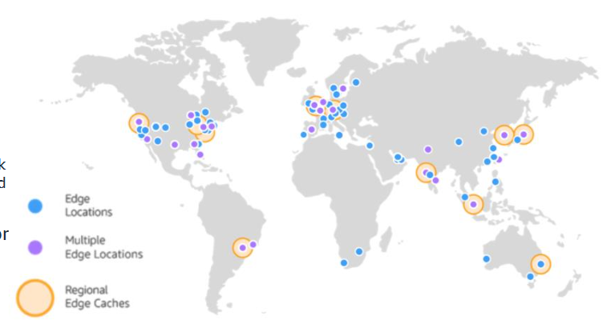
POP Points of Presence
AWS provides a global network of Points of Presence locations.
Consists of edge locations and a much smaller number of Regional edge caches.
Used with Amazon CloudFront.
A global Content Delivery Network (CDN), that delivers content to end users with reduced latency
Regional edge caches used for content with infrequent access.
Notes:
AWS Points of Presence are located in most of the major cities around the world.
By continuously measuring internet connectivity, performance and computing to find the best way to route requests, the Points of Presence deliver a better near real-time user experience.
They are used by many AWS services, including Amazon CloudFront, Amazon Route 53, AWS Shield, and AWS Web Application Firewall (AWS WAF) services.
Regional edge caches are used by default with Amazon CloudFront. Regional edge caches are used when you have content that is not accessed frequently enough to remain in an edge location.
Regional edge caches absorb this content and provide an alternative to that content having to be fetched from the origin server
Amazon CloudFront is a content delivery network (CDN) used to distribute content to end users to reduce latency.
Amazon Route 53 is a Domain Name System (DNS) service. Requests going to either one of these services will be routed to the nearest edge location automatically in order to lower latency.

Slide 8
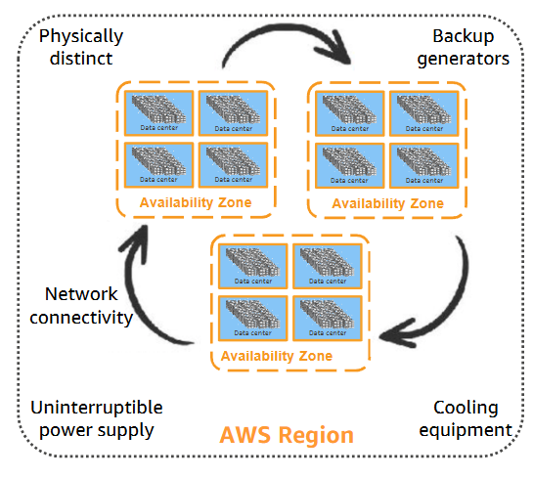
AWS infrastructure features
Elasticity and scalability.
Fault-tolerance.
High availability.
Notes:
Now that you have a good understanding of the major components that comprise the AWS Global Infrastructure, let's consider the benefits provided by this infrastructure
The AWS Global Infrastructure has several valuable features:
•First, it is elastic and scalable. This means resources can dynamically adjust to increases or decreases in capacity requirements. It can also rapidly adjust to accommodate growth.
•Second, this infrastructure is fault tolerant, which means it has built-in component redundancy which enables it to continue operations despite a failed component.
•Finally, it requires minimal to no human intervention, while providing high availability with minimal down time.

Slide 9
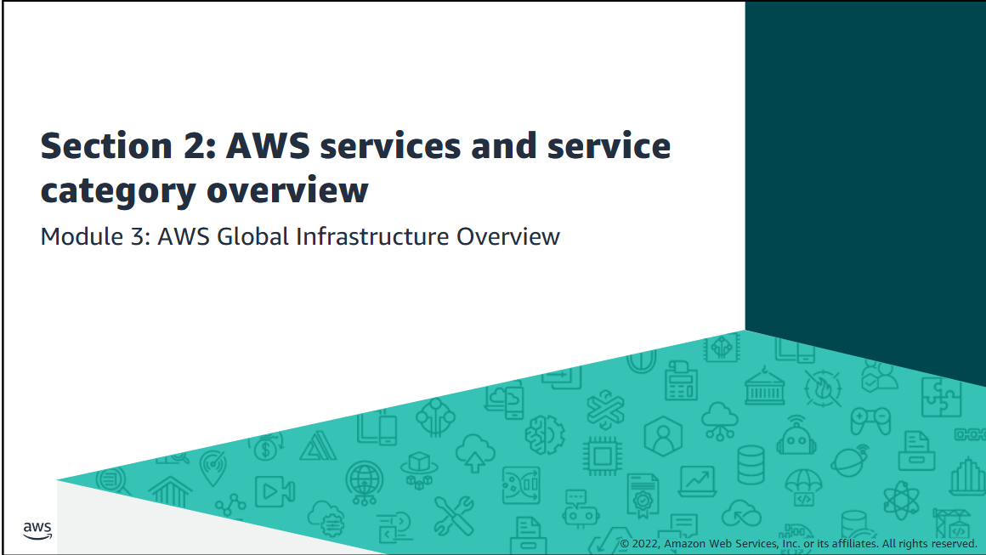
Notes:
AWS offers a broad set of global cloud-based products that can be used as building blocks for common cloud architectures.

Slide 10
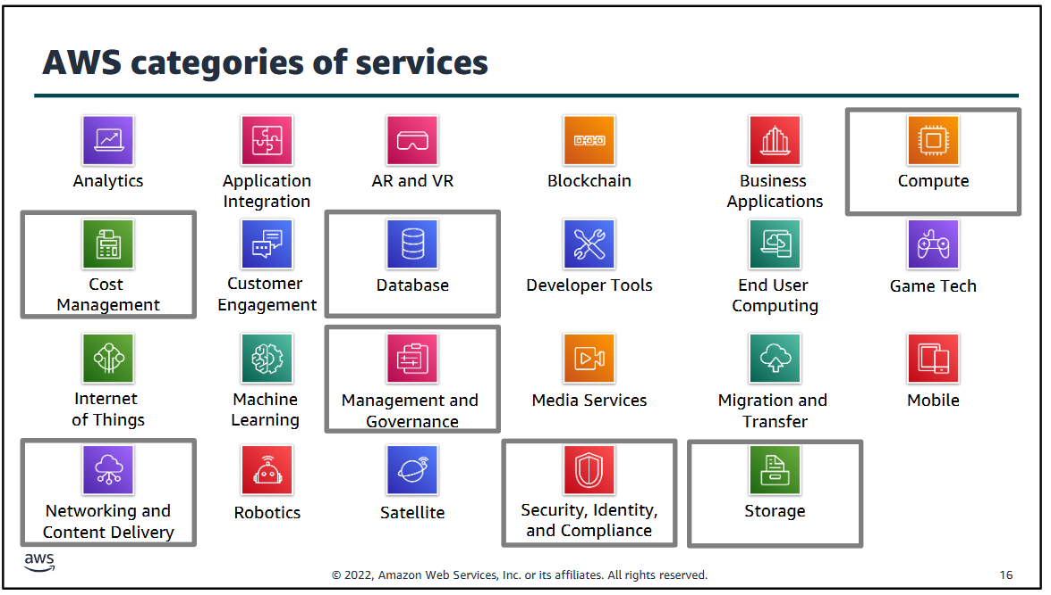

Slide 11
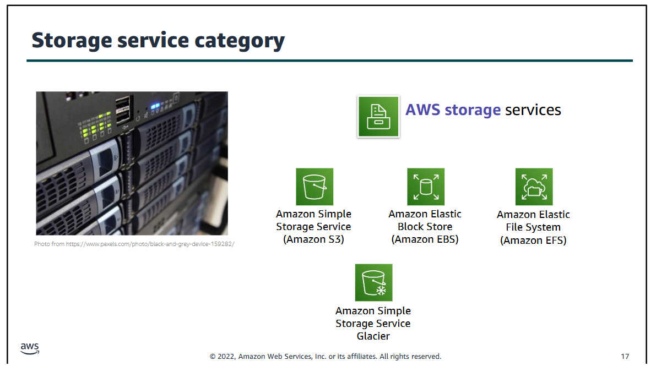

Slide 12
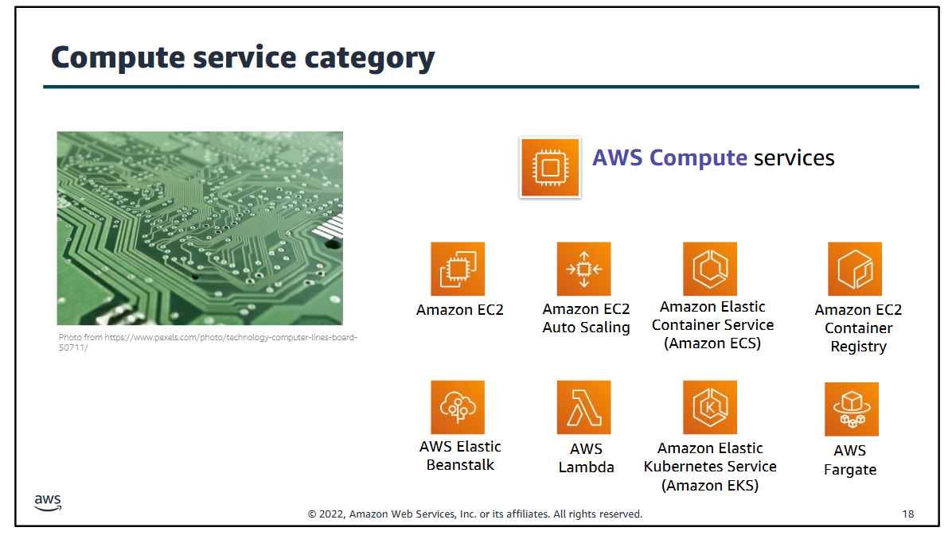

Slide 13
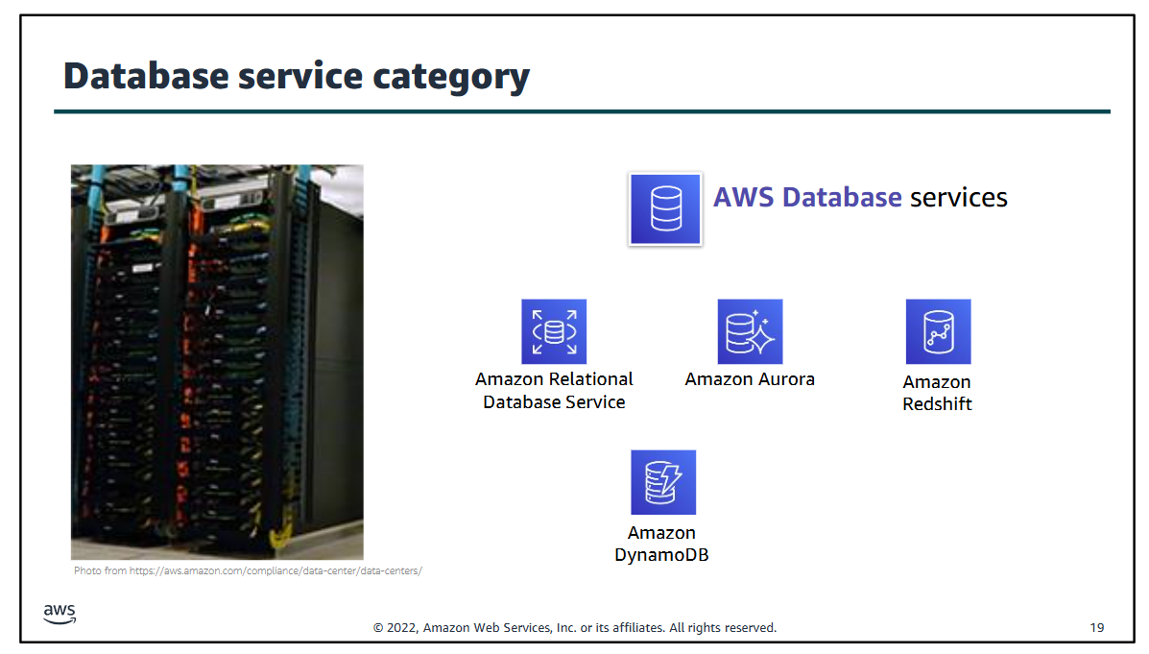

Slide 14
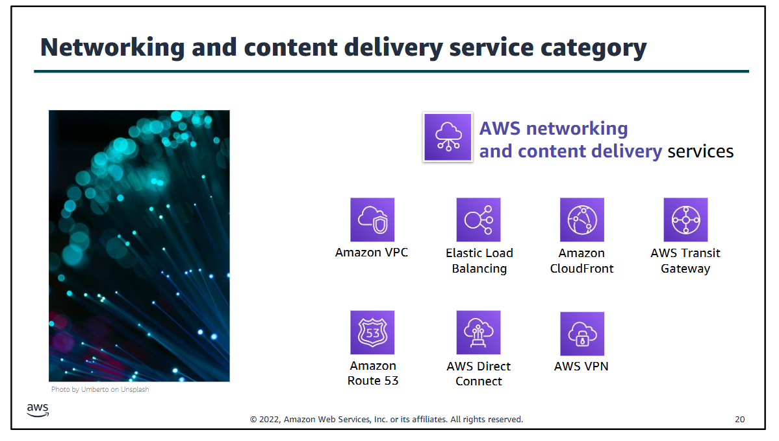

Slide 15
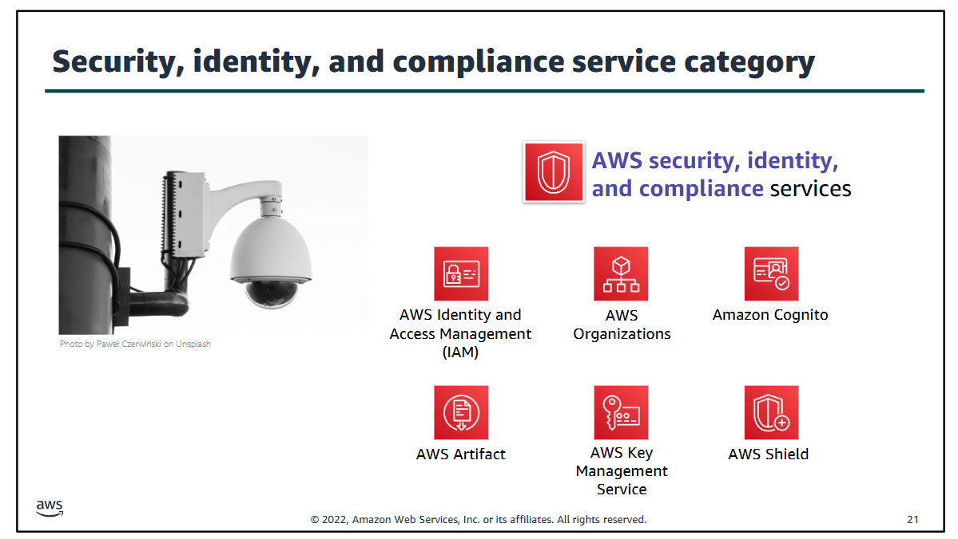

Slide 16
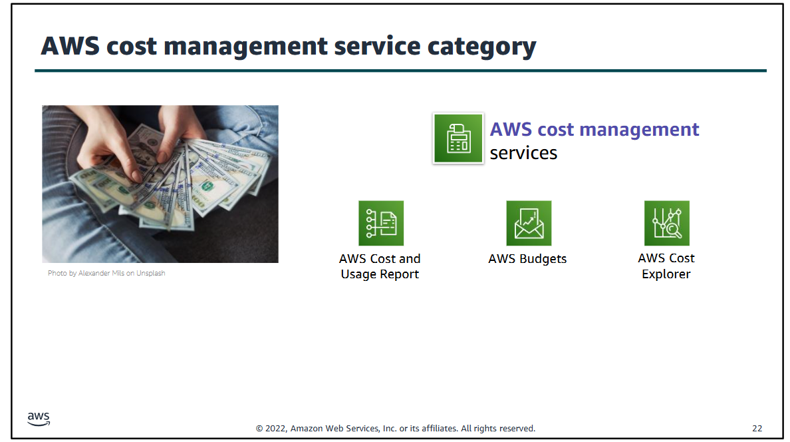

Slide 17
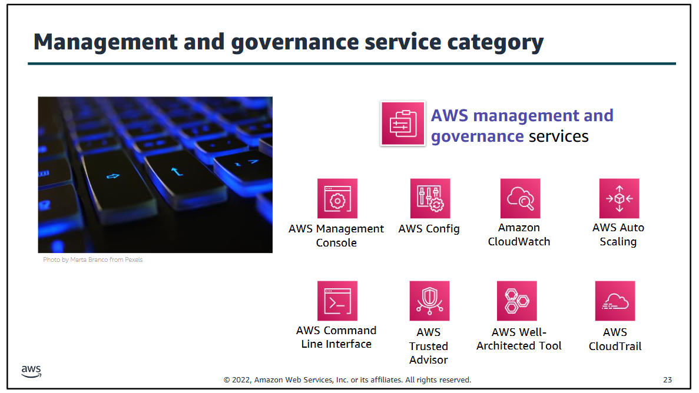

Slide 18
AWS Management console
AWS Account Creation.
AWS Management Console overview.

